Slide 1

Path Planning for Multi-UAVs Mobile Edge Computing
《机器学习》课件

Slide 2
Outline
Introduction of UAV path planning & Edge Computing
Problem description
Modeling
Simulation results and comparative analyze

Slide 3
Introduction of UAV Path planning
The need of Unmanned Aerial Vehicles (UAVs) in military field has significantly grown over the past decade.
The increasing demand has brought into focus several challenges associated with multiple UAV operation.
Reducing UAV dependence on limited numbers of expert human pilots is big concern. Ideally, the path planning should be calculated automatically.
In order to successfully carry out a complex mission, these UAVs will have to share information and cooperate among each other to perform in an better manner.
Path planning is good choice

Slide 4
Introduction of UAV Edge computing
Mobile edge computing (MEC) enables the computational power at the edge of cellular networks to flexibly and rapidly deploy applications and services towards mobile terminal users (TUs)
The UAV can be applied in MEC due to its computational ability and mobility and low cost.
In real situations where collaborative UAVs are needed to serve multiple TUs with various demand, path planning is necessary for a UAV to set up an optimal route to increase service rate, avoid obstacles and save cost simultaneously.

Slide 5
UAV Path planning
1. Obstacle avoidance
Minimize the risk of the path planning
2. Shortest path
Minimize length of path (time)
3. Edge Computing
Maximum the service rate
4. UAVs Information sharing
See other UAVs as Obstacles
4
TARGETs
*Generally the map information is partially available(With Known obstacles and TUs position)

Slide 6
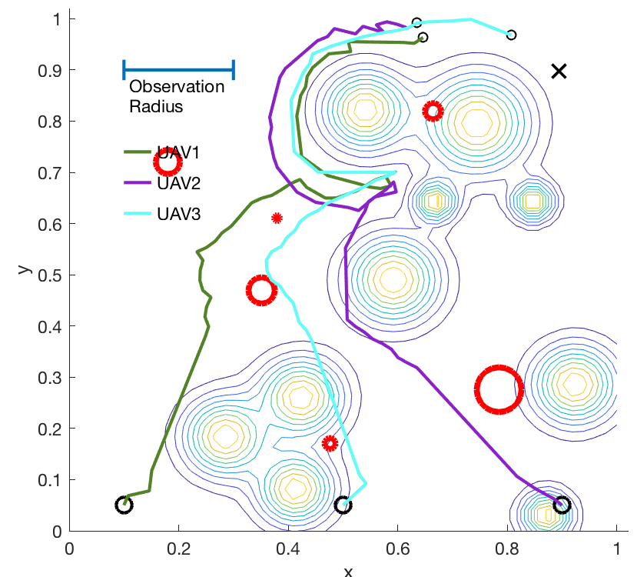
Problem Description
1. Weight Matrix
For each UAV, we should model the exposure risk of any points to obstacles(include other UAVs) within observe radius with positive weight
2. Reward Matrix
Establish a Reward matrix from updated weight matrix, Learning from it for final path planning
For each UAV, We should model accumulate service demand of any points from all TUs with negative weight
The Weight Matrix updates when new obstacle is observed and a TU is served
We want to find a path from the start point Ps to the target point Pt

Slide 7
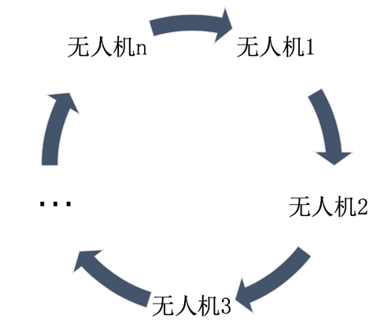
Problem Description
3. UAVs information sharing
For each UAV, update other UAVs data before re-planning
update new location information in obstacle map database after moving for other UAVs to refer
UAV n
UAV 1
UAV 2
UAV 3

Slide 8
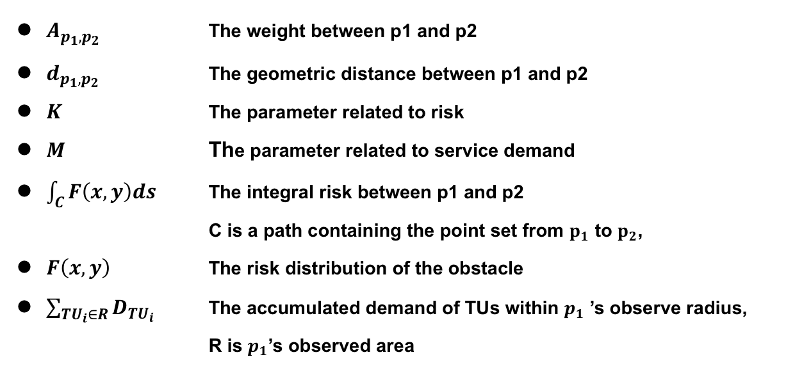
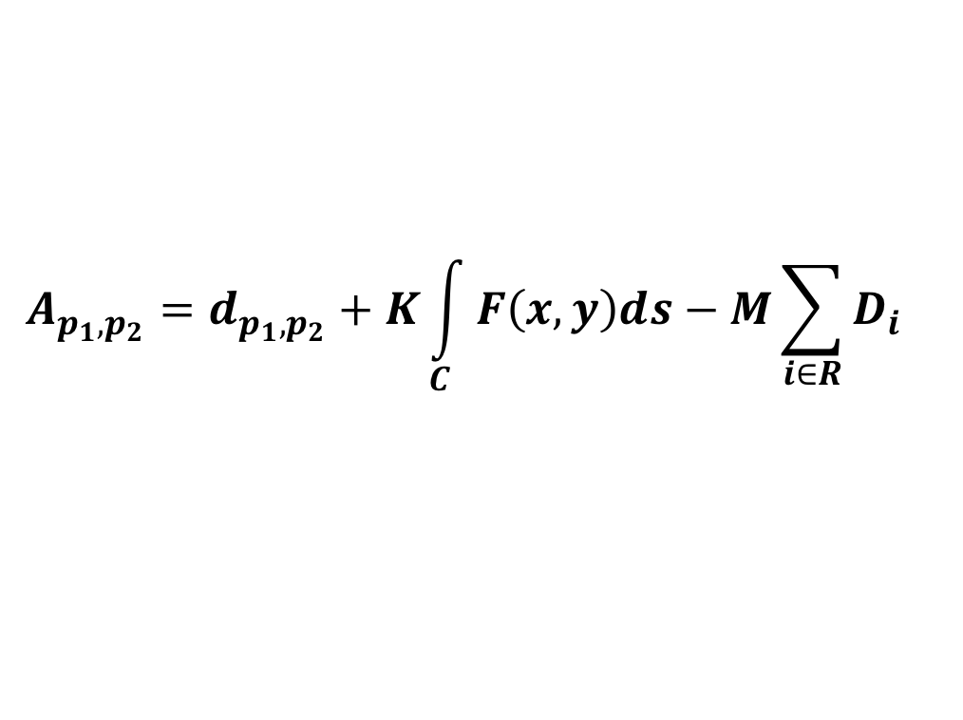
Weight Matrix
We want to find a path from the start point Ps to the target point Pt
$$A_{p_{1},p_{2}}=d_{p_{1},p_{2}}+K\int_{C}{F\left(x,y\right)ds}−M\sum_{i∈R}{D_{i}}$$
$A_{p_{1},p_{2}}$ The weight between p1 and p2
$d_{p_{1},p_{2}}$ The geometric distance between p1 and p2
$K$ The parameter related to risk
$M$ The parameter related to service demand
$\int_{C}{F\left(x,y\right)ds}$ The integral risk between p1 and p2
C is a path containing the point set from $p_{1}$ to $p_{2}$,
$F\left(x,y\right)$ The risk distribution of the obstacle
$\sum_{TU_{i}∈R}{D_{TU_{i}}}$ The accumulated demand of TUs within $p_{1}$ ’s observe radius,
R is $p_{1}$’s observed area

Slide 9
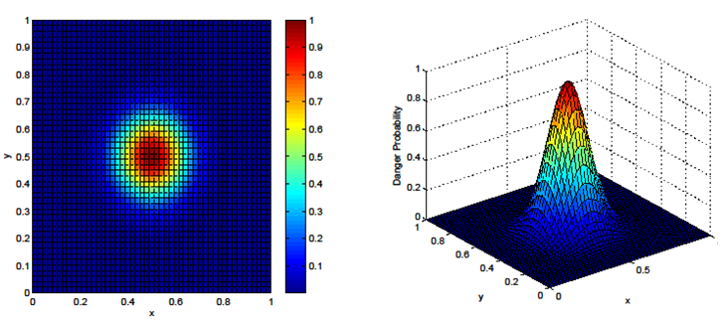
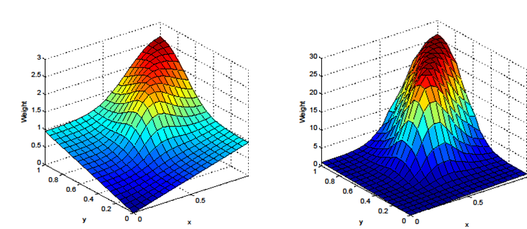
probabilistic risk exposure to obstacle
K=5
K=100

Slide 10
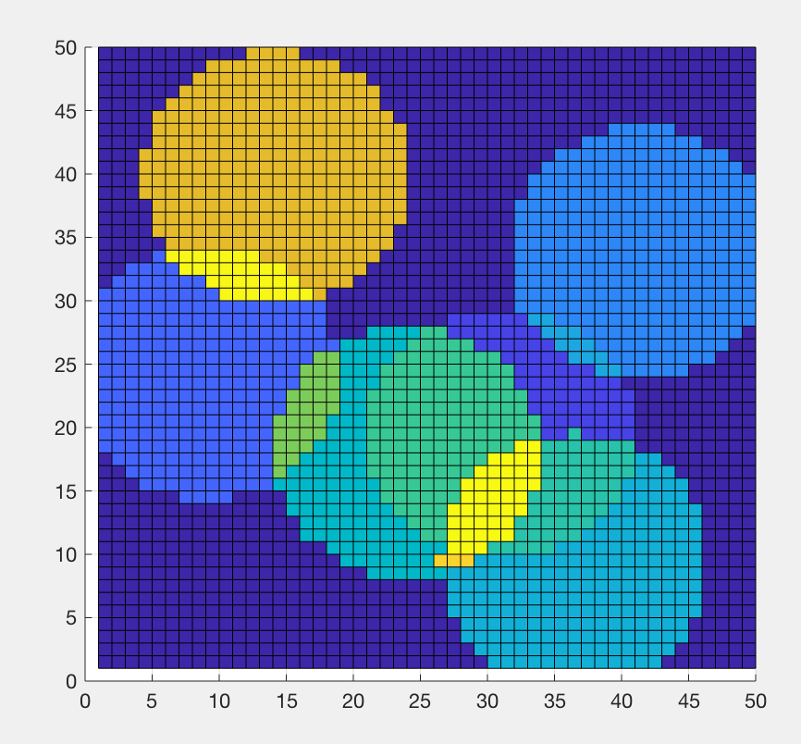
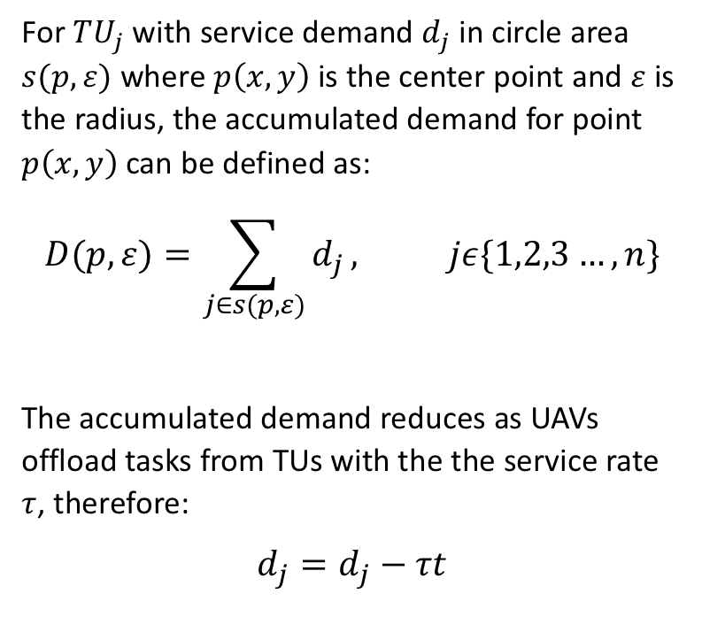
Accumulated demand from terminal user
For $TU_{j}$ with service demand $d_{j}$ in circle area $s(p,ε)$ where $p\left(x,y\right)$ is the center point and $ε$ is the radius, the accumulated demand for point $p\left(x,y\right)$can be defined as:
$$D(p,ε)=\sum_{j∈s(p,ε)}{d_{j}}, jε\{1,2,3…,n\}$$
The accumulated demand reduces as UAVs offload tasks from TUs with the the service rate $τ$, therefore:
$$d_{j}=d_{j}−τt$$

Slide 11
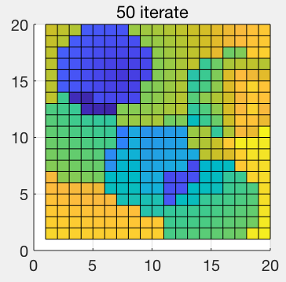
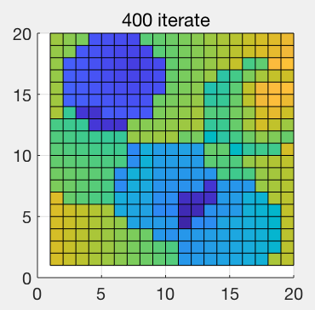
The Reward Matrix
The Reward matrix G is used to evaluate the length and risk measure of any path, and find the final path.
A is the measure between any two points, from which G is calculated by adding the elements of A together.
We can easily prove the convergence of calculating G
We can also prove that any path of G with Pt as the target point is the optimal one

Slide 12
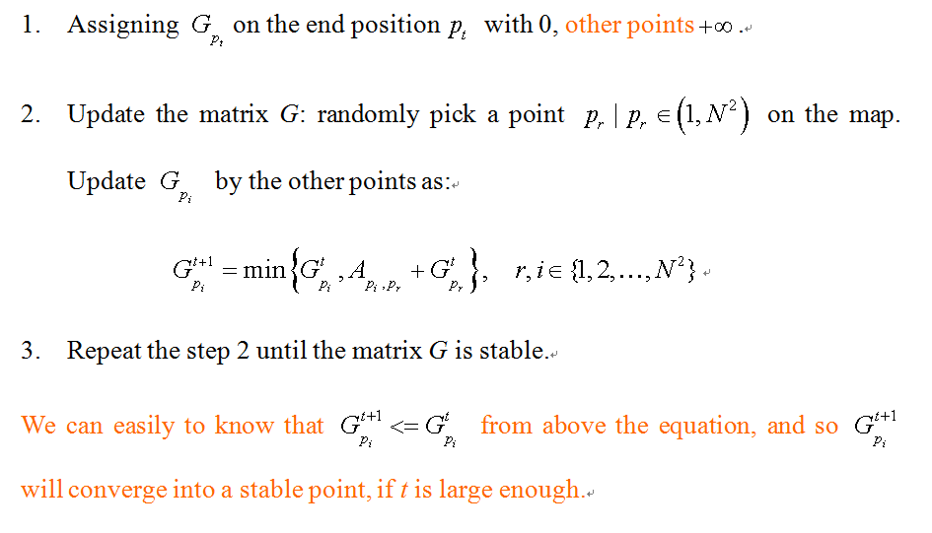
The Reward Matrix
Details of Algorithms

Slide 13
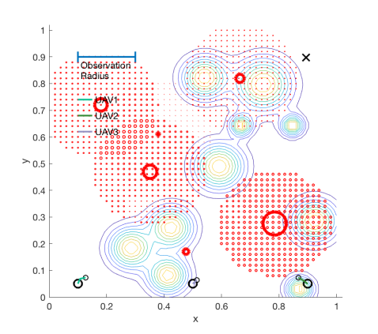
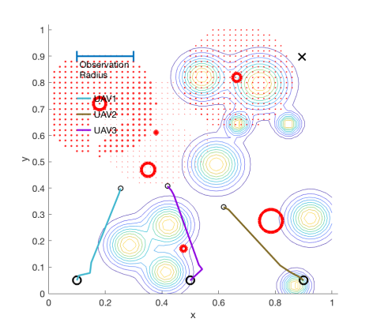
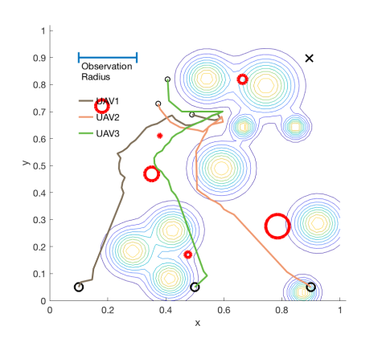
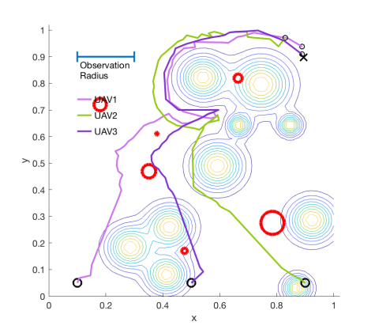
Results
K=5, M=0.5

Slide 14
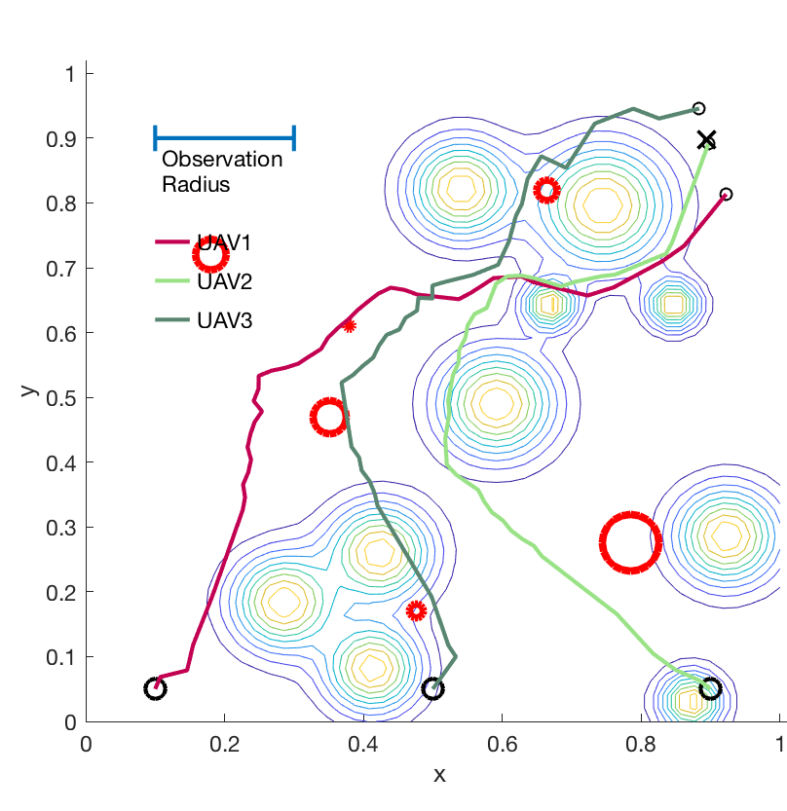
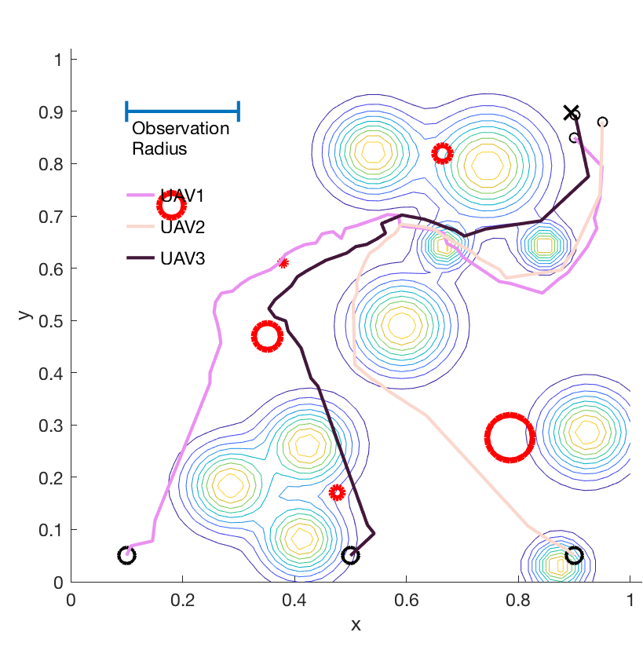

Comparison
K=5
K=10
K=20
K | M | Service rate | average path length | average risk
5 | 0.5 | 0.98 | 1.41 | 8.06
10 | 0.5 | 0.98 | 1.57 | 6.00
20 | 0.5 | 0.98 | 1.92 | 3.78

Slide 15
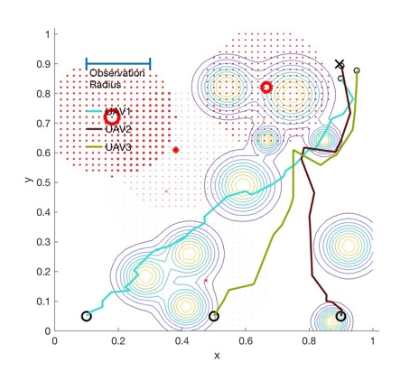
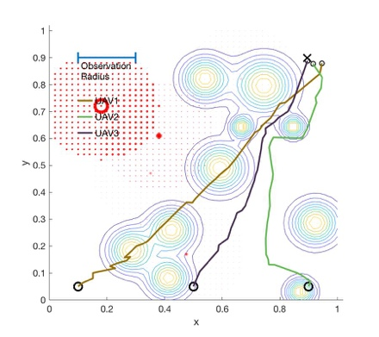
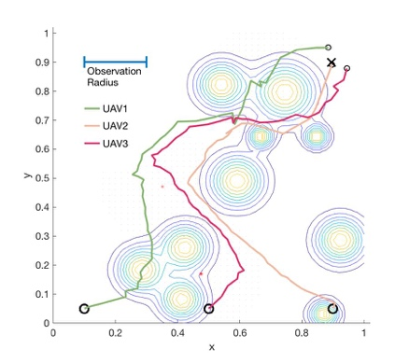
Comparison
M=0
M=0.01
M=0.05
K | M | Service Rate | Average Path Length | Average Risk
5 | 0 | 0.62 | 1.13 | 8.03
5 | 0.01 | 0.74 | 1.09 | 9.31
5 | 0.02 | 0.74 | 1.13 | 9.48
5 | 0.03 | 0.79 | 1.33 | 8.32
5 | 0.04 | 0.84 | 1.33 | 8.03
5 | 0.05 | 0.98 | 1.49 | 8.77

